Slide 1
Risk measurement for portfolios in Fixed-income and Currency markets
Christian Carmona
STAT 222 Midterm Presentation
March 19, 2014

Slide 2
Research question and Audience
Introduction
Objective and Audience
Objective
Estimate the maximum loss generated by fluctuation in market prices for a portfolio comprised with Fixed-Income instruments and spot position in several foreign currencies.
Audience
Portfolio managers, Investors, Investment banks, regulators and general public with interest to invest in the fixed-income and currency markets.

Slide 3
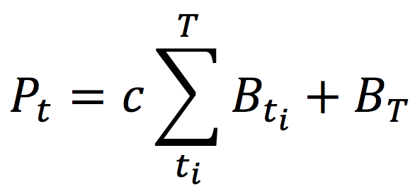
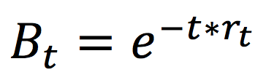
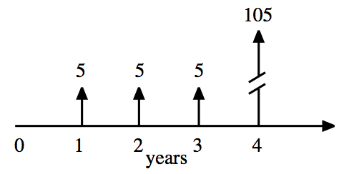
Exposure identification
Implementation
Model specification
Fixed-Income instruments
Price=PV of bond cash flows: coupon + principal
where:
Spot position in currencies
The risk exposure of these positions are function of the exchange rate.
Bonds denominated in foreign exchange are also under the effect of this factor.

Slide 4
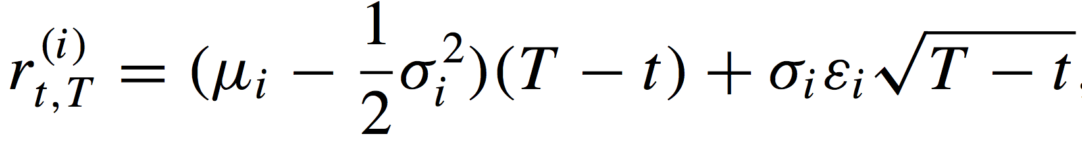
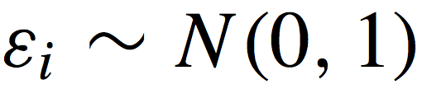
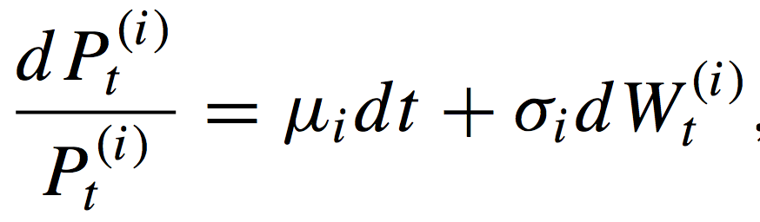
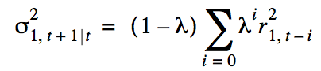
Risk Factor dynamics
Implementation
Model specification
Factors driving the prices of financial securities in the portfolio are zero-coupon interest rates and foreign exchange rates.
We suppose that the process generating the changes for the i-th risk factor can be written as:
It follows that the return on each asset from time t to time t+T can be written as:
With:
Volatilities and covariances are estimated using a EWMA

Slide 5
Data set
Implementation
Data Set
Treasury Yield Curve Rates
Source: US Department of treasury, Resource Center http://www.treasury.gov/resource-center
Daily quotes with the yield-to-maturity rates for terms covering: 3m, 6m, 1y, 2y,5y,…,30y
A xml file for each year 2006-2014
Data located in label text
Foreign Exchange Rates
Source: US Federal Reserve, data download program http://www.federalreserve.gov/datadownload
Daily exchange rates for most of the currencies in the world.
Zip file containing one xlm file for historical data
Data nested inside label attributes

Slide 6
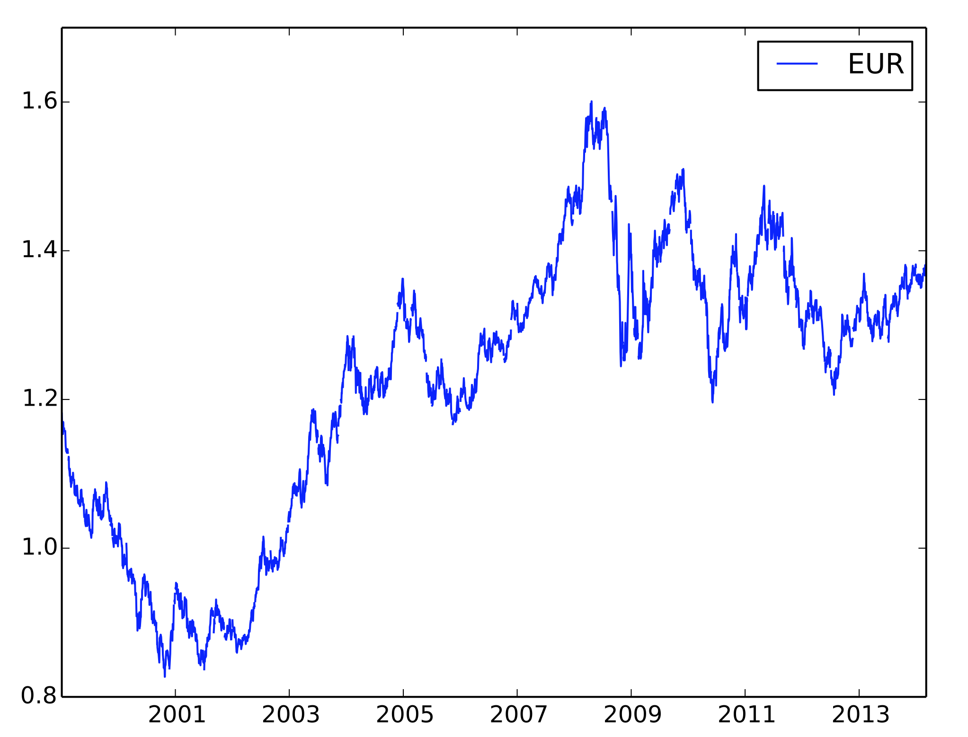
Currencies
Implementation
Historical Data
USD per EUR
Date

Slide 7
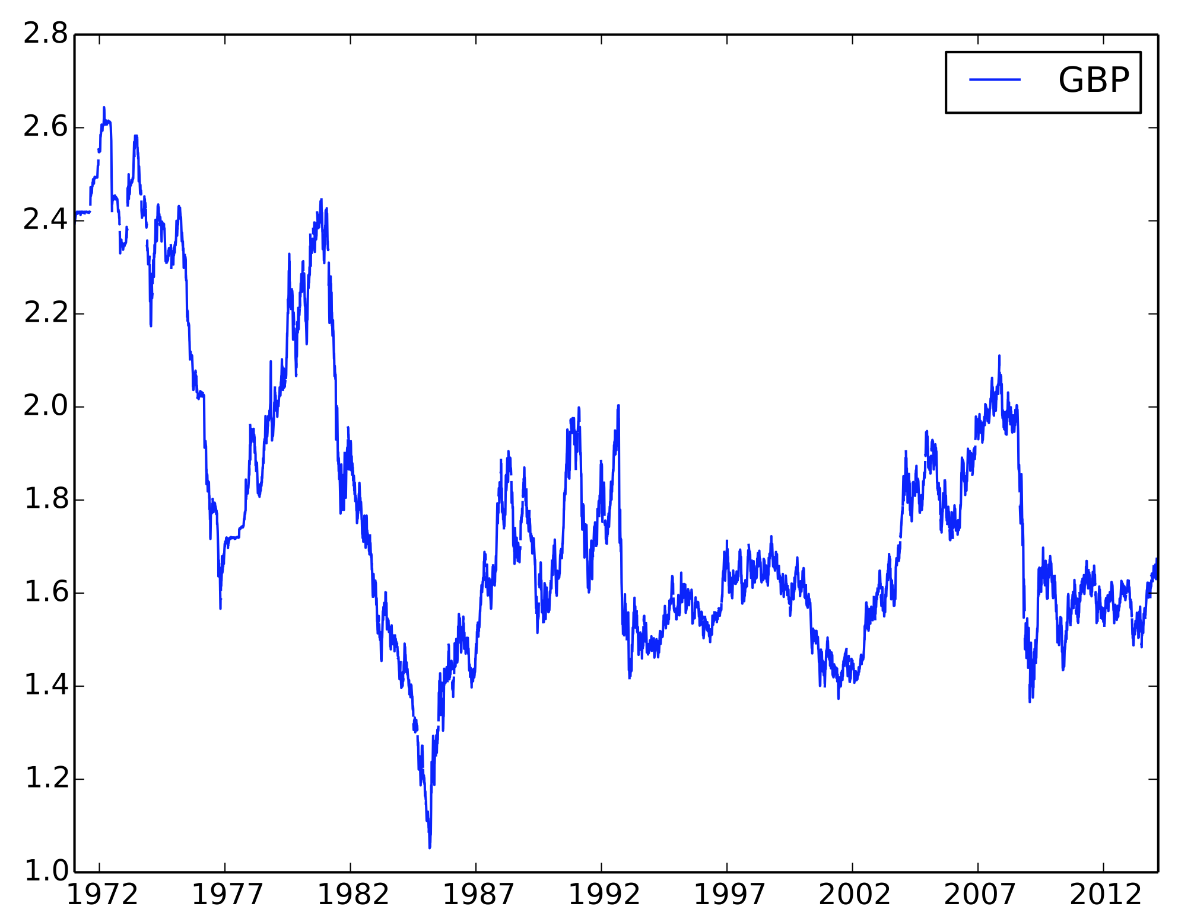
Currencies
Implementation
Historical Data
USD per GBP
Date

Slide 8
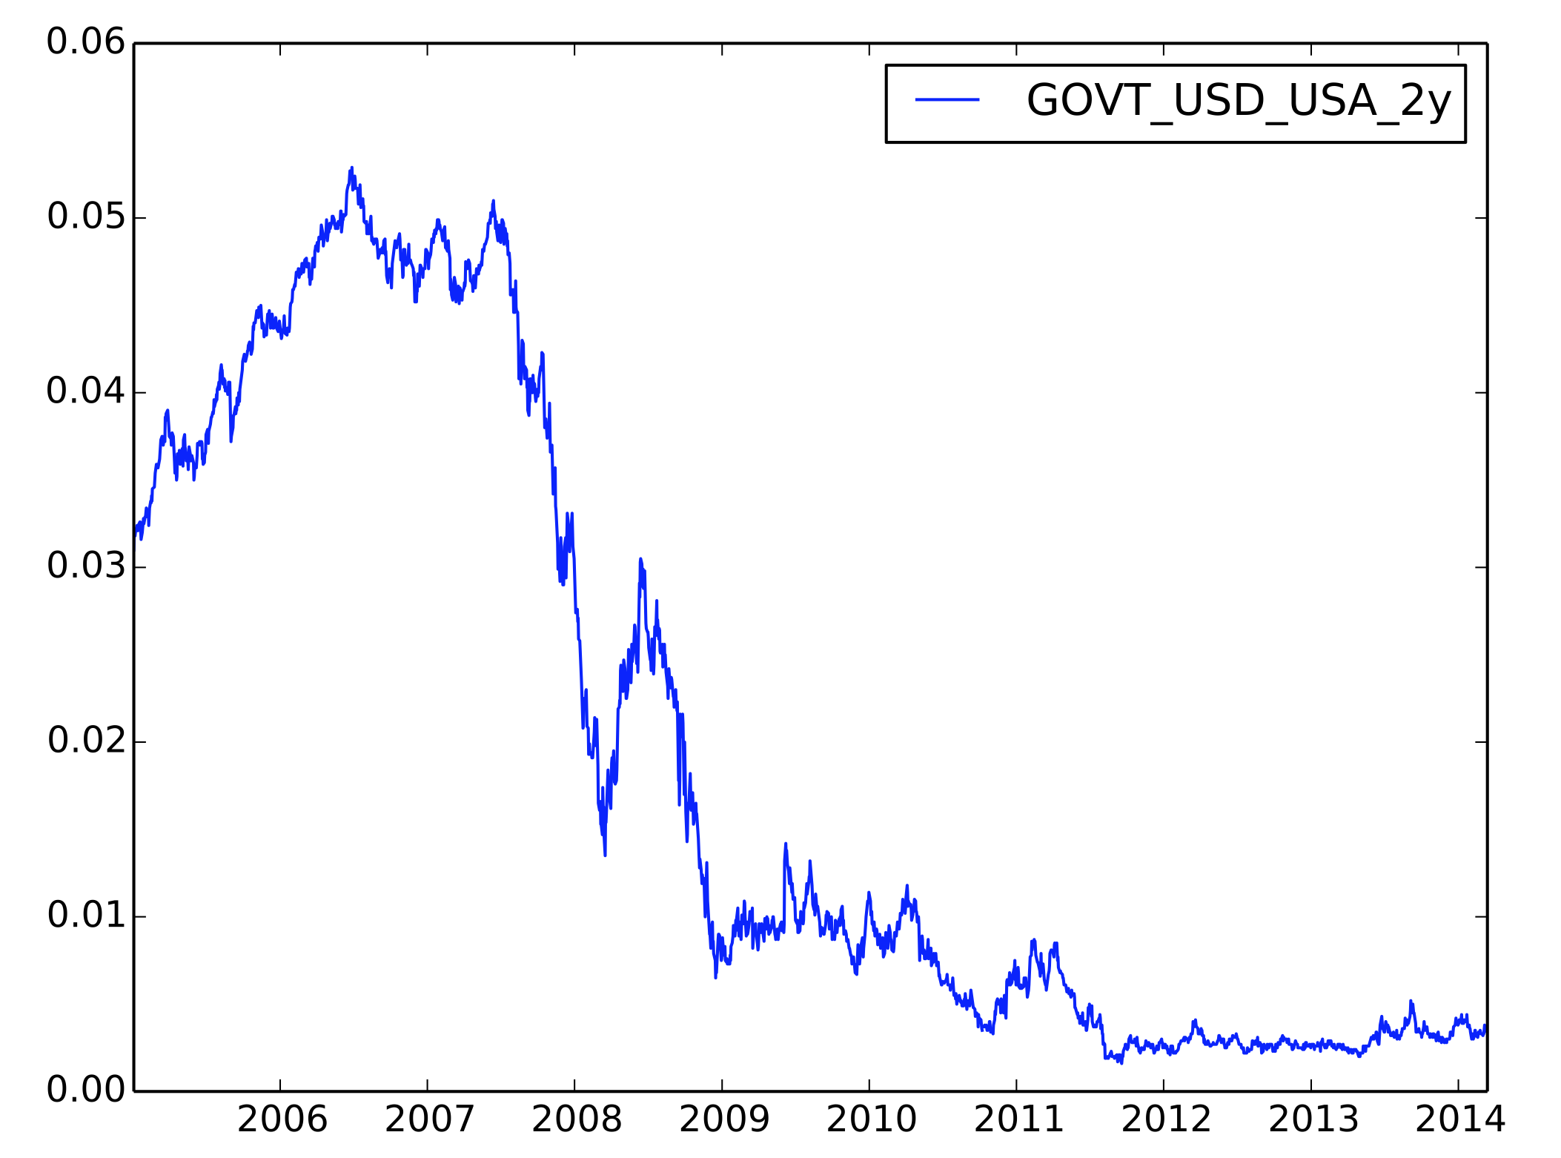
Treasury Rates
Implementation
Historical Data
Yield
Date

Slide 9
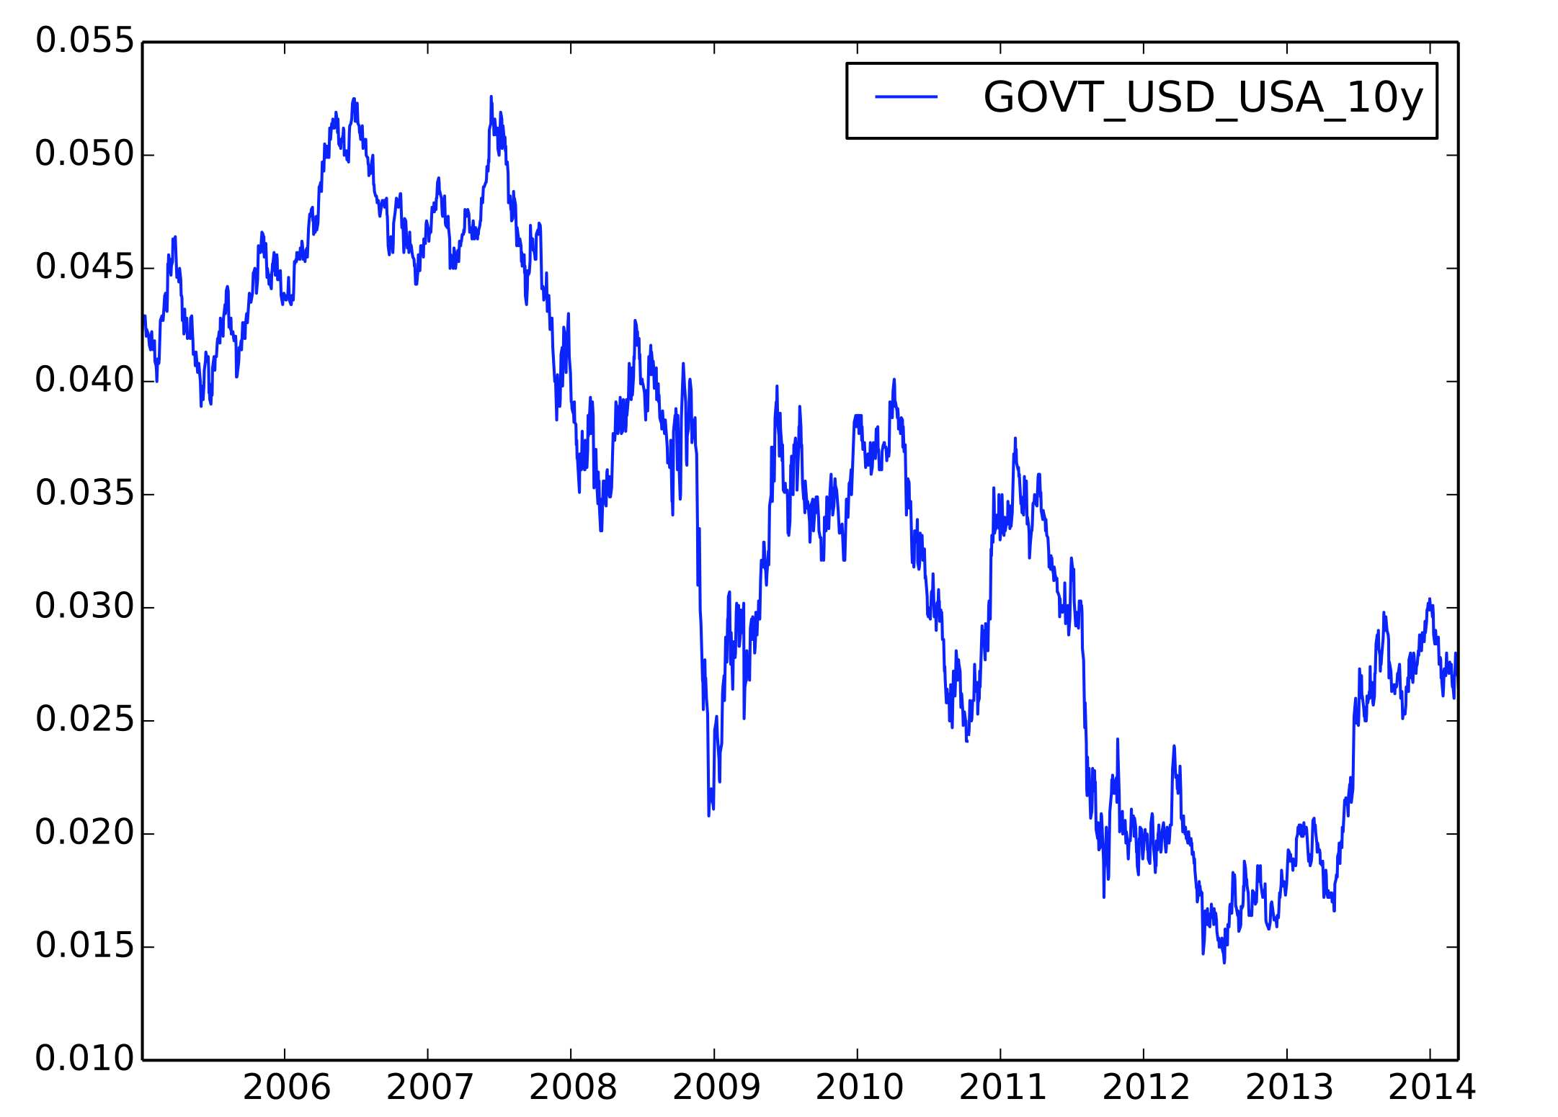
Treasury Rates
Implementation
Historical Data
Yield
Date

Slide 10
YTM to zero-coupon yields (Bootstrap method)
Implementation
Historical Data
Yield
Maturity (years)

Slide 11
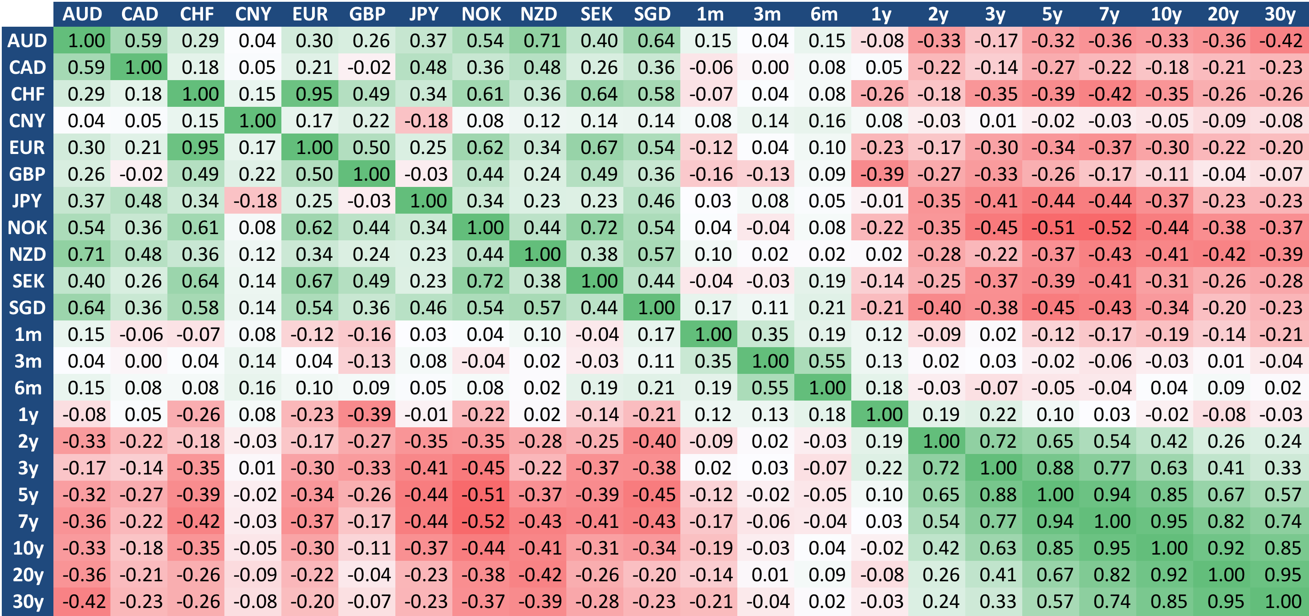
Correlation estimation
Results
Covariance

Slide 12
Implementation
Algorithm Flow Diagram
Portfolio specification
Load instruments information
Identification of risk factors
Identify portfolio’s exposure
Obtain historical information
Portfolio valuation under current prices
Estimation of model parameters:
E(R_{i}), Cov_{t}(R_{i},R_{j})
Simulation of risk factors
Portfolio valuation under simulated scenarios
Profit & Losses
Distribution
Market Risk Measures:
VaR , CVaR

Slide 13
IPython notebook implementation
Implementation
IPython Notebook
This project implemented RiskMetrics methodology in IPython notebook.
Data Loading
Portfolio loading
Simulation of risk factors (scenarios)
Cash flows identification
Portfolio Valuation
P&L calculation
Estimation of Value-at-Risk
Back testing
Benefits
Indexing properties
Time Series attributes
Problems
Visualization of big data frames
Plotting customization

Slide 14
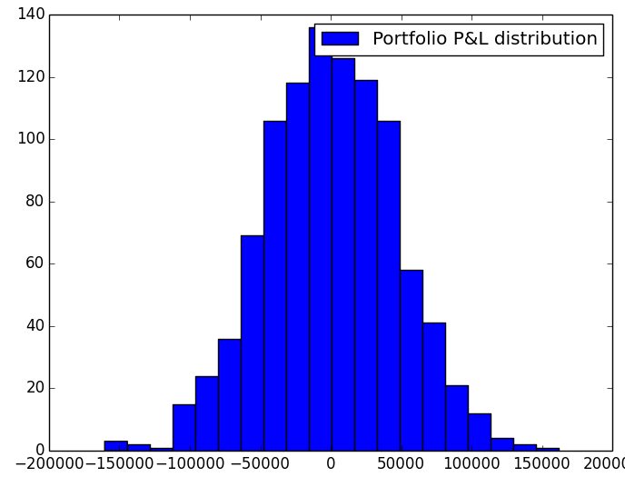
Value-at-Risk Estimation
Results
VaR estimation
Level (%) | Portfolio Value-at-Risk (USD)
90 | 60,336
95 | 74,573
97.5 | 92,676
99 | 106,956
P&L (USD)

Slide 15
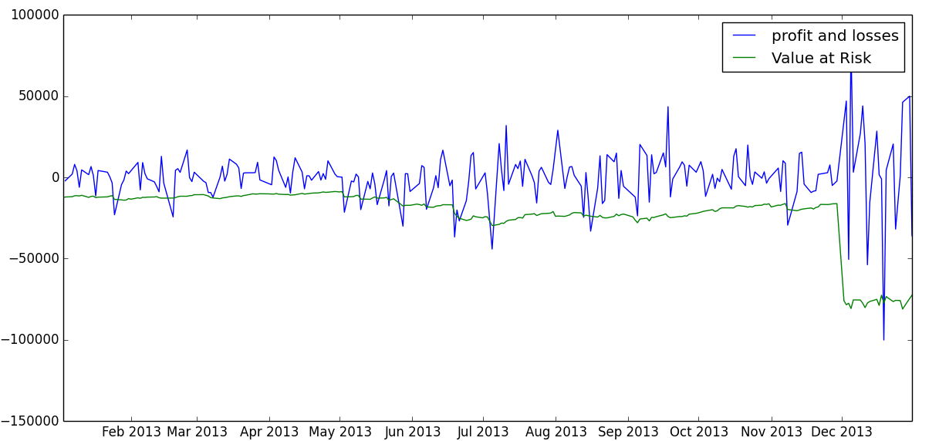
Back testing
Back testing
2013
USD
Date

